Slide 1
Interval Tree
Pro Academy I
Data Structure
Notes:
By leonardi.l

Slide 2
Definition
An augmented RBT
Additional attribute :
high (interval.high)
low (interval.low)
max
Support interval trichotomy, check whether two interval A and B :
A and B is overlap
A is to the left of B (A.high < B.low)
A is to the right of B (B.high < A.low)

Slide 3
Operations
Same as BST, but also maintaining interval trichotomy
INTERVAL-INSERT(T, x) adds the element x, whose interval attribute is assumed to contain an interval, to the interval tree T.
INTERVAL-DELETE(T, x) removes the element x from the interval tree T.
INTERVAL-SEARCH(T, x) returns a pointer to an element x in the interval tree T such that x:int overlaps interval i, or a pointer to the sentinel T:nil if no such element is in the set.
Notes:
* getMini(): It returns the root element of Min Heap. Time Complexity of this operation is O(1).
* extractMin(): Removes the minimum element from Min Heap. Time Complexity of this Operation is O(Logn) as this operation needs to maintain the heap property (by calling heapify()) after removing root.
* decreaseKey(): Decreases value of key. Time complexity of this operation is O(Logn). If the decreases key value of a node is greater than parent of the node, then we don’t need to do anything. Otherwise, we need to traverse up to fix the violated heap property.
* insert(): Inserting a new key takes O(Logn) time. We add a new key at the end of the tree. IF new key is greater than its parent, then we don’t need to do anything. Otherwise, we need to traverse up to fix the violated heap property.
* delete(): Deleting a key also takes O(Logn) time. We replace the key to be deleted with minum infinite by calling decreaseKey(). After decreaseKey(), the minus infinite value must reach root, so we call extractMin() to remove key.

Slide 4
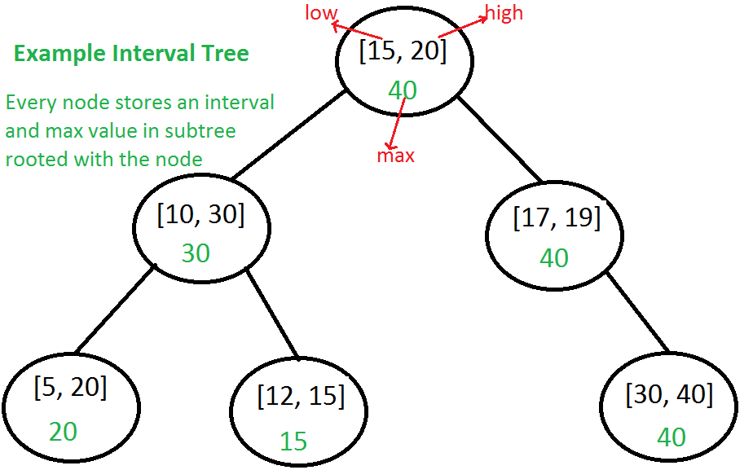
Construction
// Structure to represent an interval
struct Interval {
int low, high;
};
// Structure to represent a node in Interval Search Tree
struct ITNode {
// 'i' could also be a normal variable
Interval *i;
int max;
ITNode *left, *right;
};

Slide 5
Insertion
ITNode *insert(ITNode *root, Interval i) {
// Base case: Tree is empty, new node becomes root
if (root == NULL) return newNode(i);
// Get low value of interval at root
int l = root->i->low;
// If root's low value is smaller, then new interval goes to
// left subtree. Else, new node goes to right subtree.
if (i.low < l) root->left = insert(root->left, i);
else root->right = insert(root->right, i);
// Update the max value of this ancestor if needed
if (root->max < i.high) root->max = i.high;
return root;
}

Slide 6
Search for Interval
Interval overlappingIntervalSearch(root, x)
If x overlaps with root's interval, return the root's interval.
If left child of root is not empty and the max in left child is greater than x's low value, recur for left child
Else recur for right child.

Slide 7
Search Overlap
Interval *overlapSearch(ITNode *root, Interval i) {
// Base Case, tree is empty
if (root == NULL) return NULL;
// If given interval overlaps with root
if (doOVerlap(*(root->i), i))return root->i;
if (root->left != NULL && root->left->max >= i.low)
return overlapSearch(root->left, i);
// Else interval can only overlap with right subtree
return overlapSearch(root->right, i);
}
bool doOVerlap(Interval i1, Interval i2) {
if (i1.low <= i2.high && i2.low <= i1.high)
return true;
return false;
}

Slide 8
Speed
Algorithm | Average | Worst Case
Space | O(n) | O(n)
Search | O(log n) | O(log n)
Insert | O(log n) | O(log n)
Delete | O(log n) | O(log n)

Slide 9
Variants
Segment tree
"which of these intervals contains a given point"
Interval tree
"which of these intervals overlap with a given interval"
Range tree
"which points fall within a given interval“
Binary indexed tree
"how many items are there between index m and n"
Notes:
https://stackoverflow.com/questions/17466218/what-are-the-differences-between-segment-trees-interval-trees-binary-indexed-t

